Slide 1


Slide 2
Why OpenStreetMap is not known more widely
about consequences of not enforcing
attribution requirements
Mateusz Konieczny
mapsaregreat.com

Slide 3
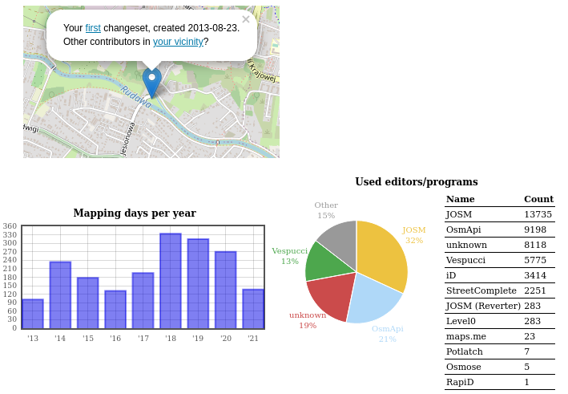
by Mateusz Konieczny
quite active mapper

Slide 4
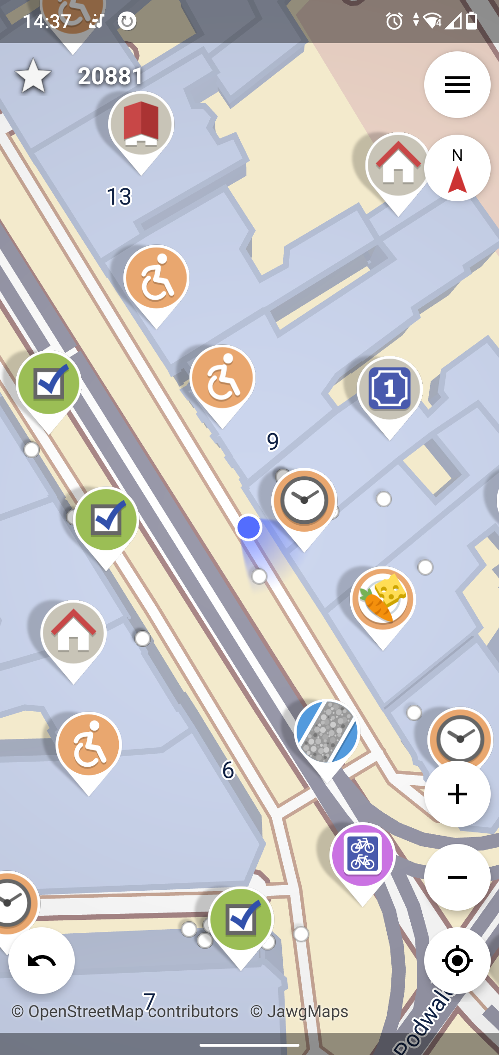
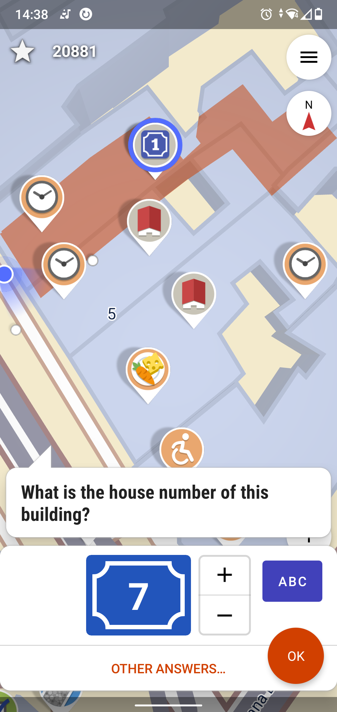
involved in making OpenStreetMap-related software, especially StreetComplete

Slide 5
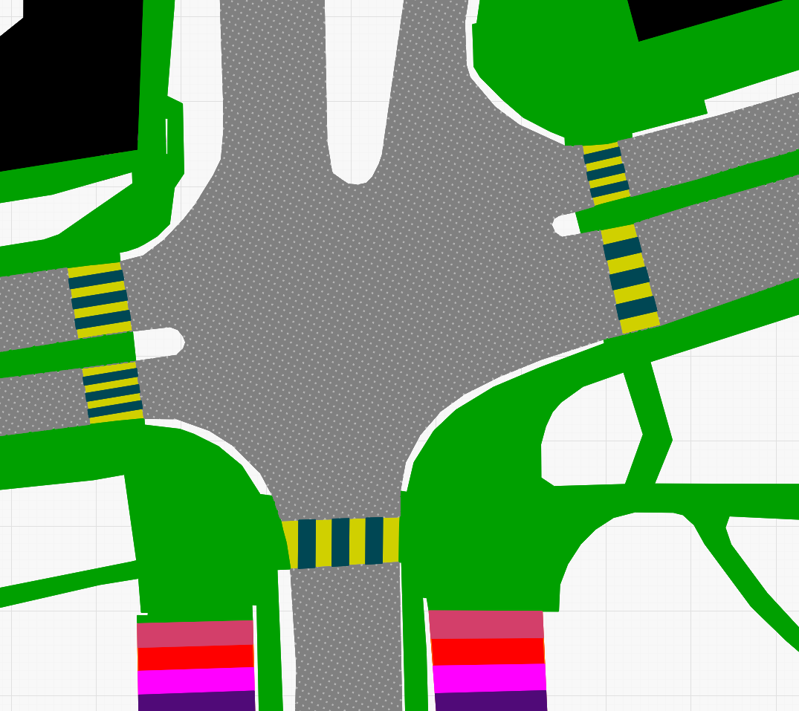
3D tactile map
Delivered to the school for children blind and with poor eyesight
made from OpenStreetMap data (ODBL license)
relies on
area:highway=*
building=* areas
the first prototype
(supported by OSMF microgrant)

Slide 6
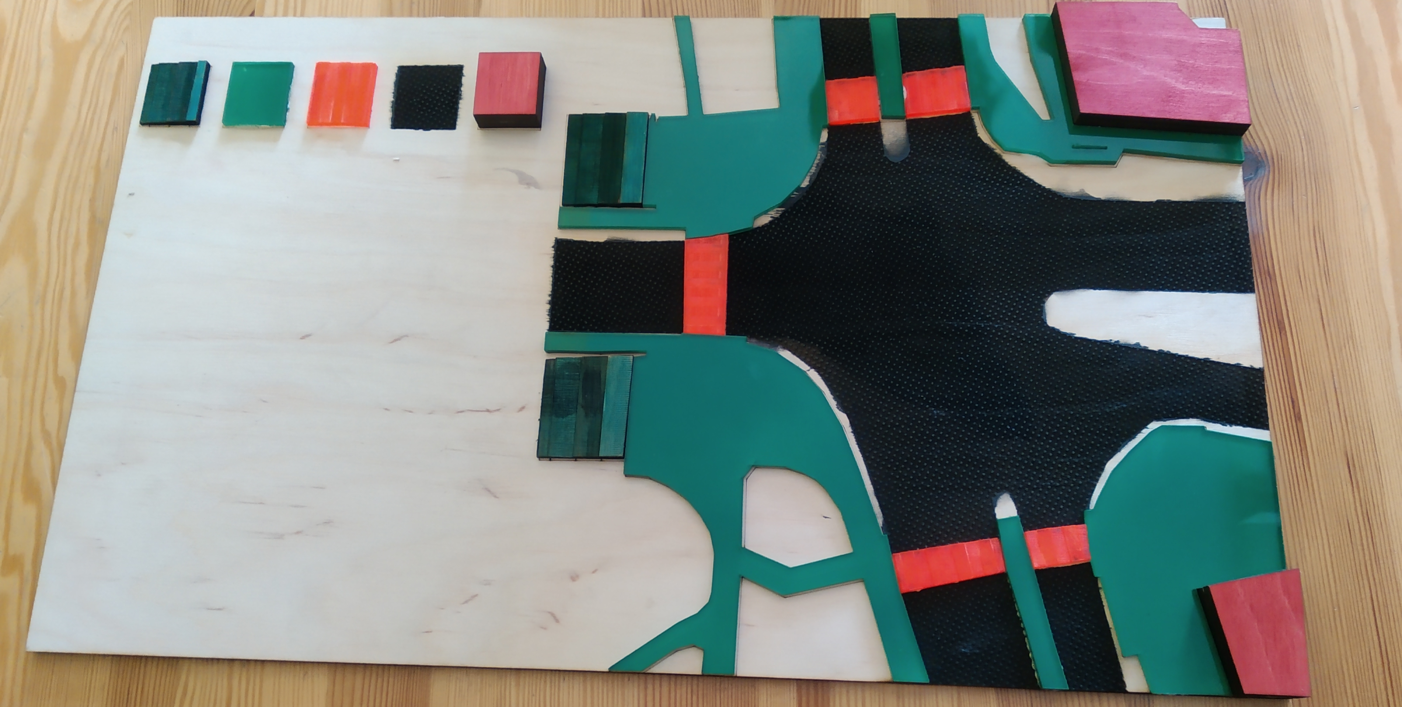
3D tactile map
Delivered to the school for children blind and with poor eyesight
made from OpenStreetMap data (ODBL license)
relies on
area:highway=*
building=* areas
the first prototype
(supported by OSMF microgrant)

Slide 7
Thanks!
To everyone who is using OpenStreetMap data and has honestly tried to credit it
  thanks also to people who fixed missing attribution

Slide 8
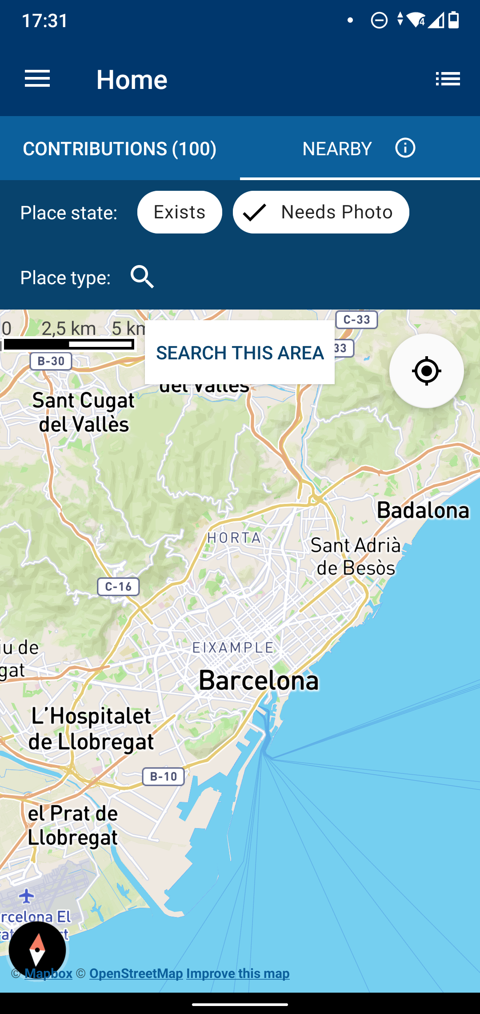
Wikimedia Commons
app
https://github.com/commons-app/apps-android-commons/issues/3766
Reaction after 24 hours
Fixed within three months
Published soon after that

Slide 9
Wikimedia Commons
app
https://github.com/commons-app/apps-android-commons/issues/3766
Reaction after 24 hours
Fixed within three months
Released soon after that

Slide 10
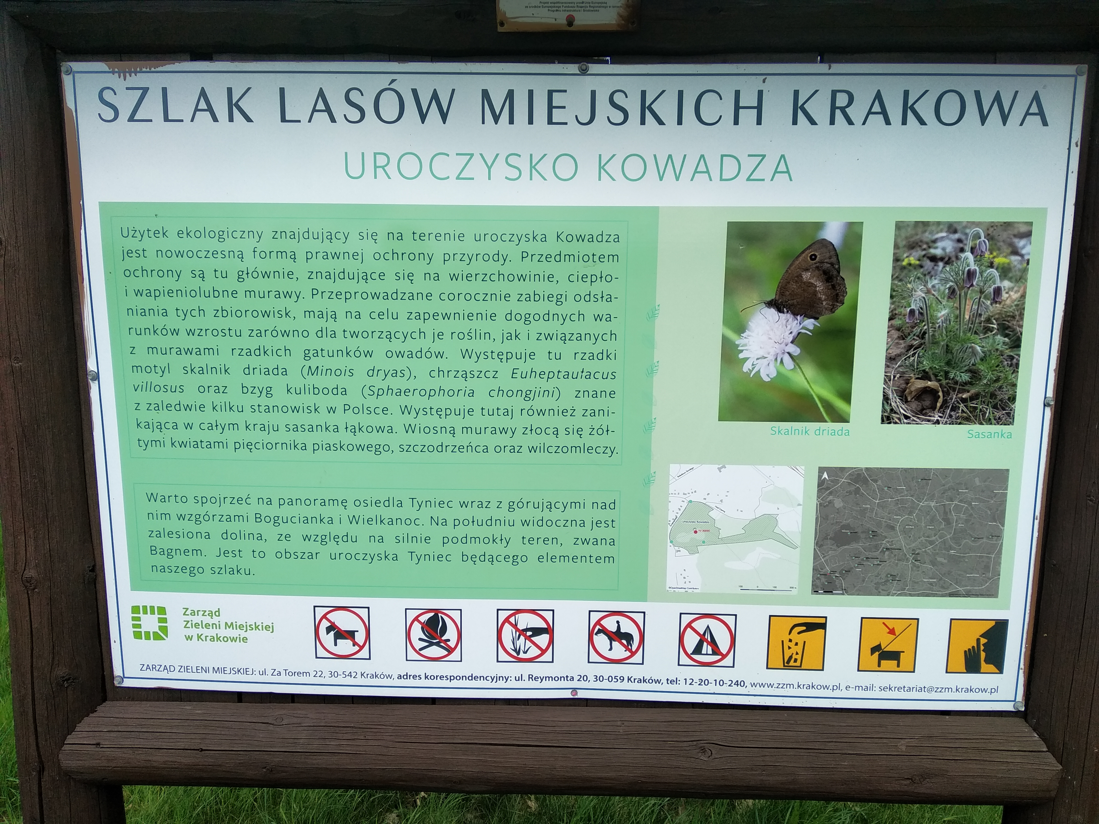
Zarząd Zieleni Miejskiej w Krakowie
https://www.openstreetmap.org/node/8701652782

Slide 11
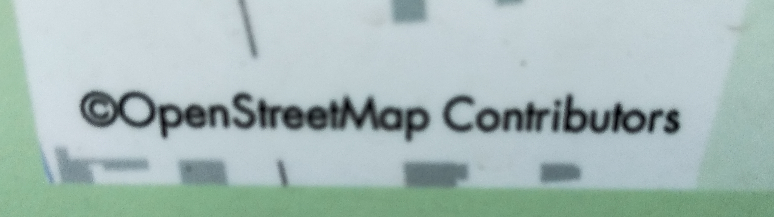
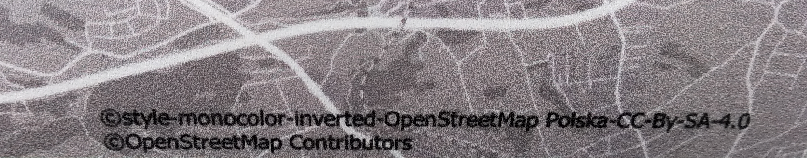
Zarząd Zieleni Miejskiej w Krakowie
https://www.openstreetmap.org/node/8701652782

Slide 12

OsmAnd
https://github.com/osmandapp/OsmAnd/issues/7219
Reaction after 24 hours
Fixed week later
Published soon after that

Slide 13

OsmAnd
https://github.com/osmandapp/OsmAnd/issues/7219
Reaction after 24 hours
Fixed week later
Published soon after that

Slide 14
And there are many other examples!
Thanks to everyone who placed a clearly visible attribution.
Also on mobile devices.

Slide 15
What is the point of OpenStreetMap?
MAPS.ME has great maps already

Slide 16
You must include a notice associated with the Produced Work reasonably calculated to make any Person that uses, views, accesses, interacts with, or is otherwise exposed to the Produced Work aware that Content was obtained from the Database, Derivative Database, or the Database as part of a Collective Database, and that it is available under this License.
From ODbL, license of OpenStreetMap data
https://www.openstreetmap.org/copyright
https://opendatacommons.org/licenses/odbl/1-0/
https://wiki.openstreetmap.org/wiki/Draft_Attribution_Guideline/2021v0.9

Slide 17
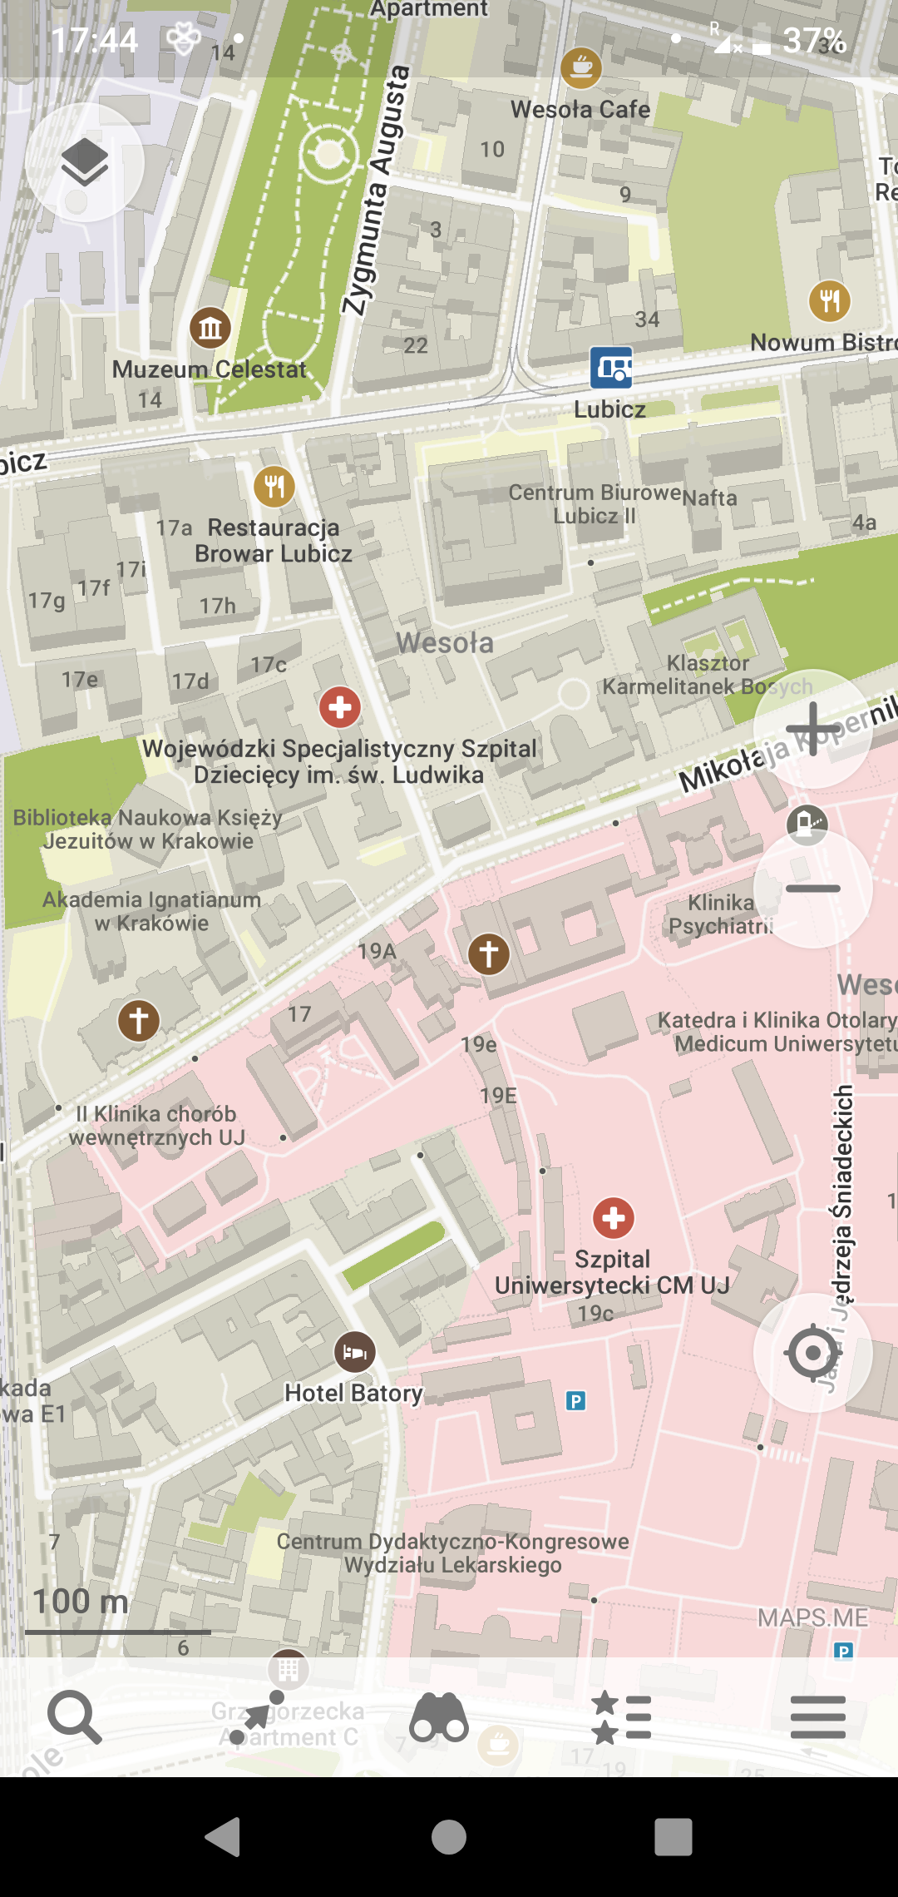

MAPS.ME
https://github.com/mapsme/omim/issues/11203 https://github.com/mapsme/omim/issues/11845
Reaction after a week
But not fixed after two years

Slide 18

OpenStreetMap “mentioned”
Blocked by an internal ad
Shown for two seconds
MAPS.ME is shown forever
MAPS.ME
https://github.com/mapsme/omim/issues/11203 https://github.com/mapsme/omim/issues/11845
Reaction after a week
But not fixed after two years

Slide 19
We need more mappers
OSM would benefit from more mappers
There are multiple barriers of different types

Slide 20
Barriers (examples)
Society-wide ones
  poverty
  stereotypes
Technical traps
  registration form
Community also can be improved
OpenStreetMap? What is that?

Slide 21
People unaware that OSM exists will not join to map the world

Slide 22
OpenStreetMap community has a legal and ethical right to demand a clear attribution

Slide 23
Not every use of OpenStreetMap data requires attribution
Examples:
Tiny extracts
  for example a position of a single node
Private use
  for example in a private diary
De minimis
  screen with OSM as a background detail

Slide 24
But what would be typically described as using OpenStreetMap data requires it
Examples:
Map in app available to public
Map given as a gift to a friend
Map in a public place

Slide 25
Warning:
I am not a lawyer
Consult a lawyer if you need a lawyer. But it is clear, no lawyer required, that:
ODbL license of OpenStreetMap requires a clearly visible attribution
Many uses of OpenStreetMap data have no clearly visible attribution

Slide 26
Why OpenStreetMap benefits from being known more widely
More contributors, users
More diverse contributors
Treated more seriously
Yes, there are also negatives
  more vandals, risk of flood of new users

Slide 27
Other entities using OpenStreetMap data without attribution
“Lacking proper attribution” on the OSM Wiki
  https://wiki.openstreetmap.org/wiki/Lacking_proper_attribution
My listing of eggregious cases
  https://github.com/matkoniecz/illegal-use-of-OpenStreetMap

Slide 28
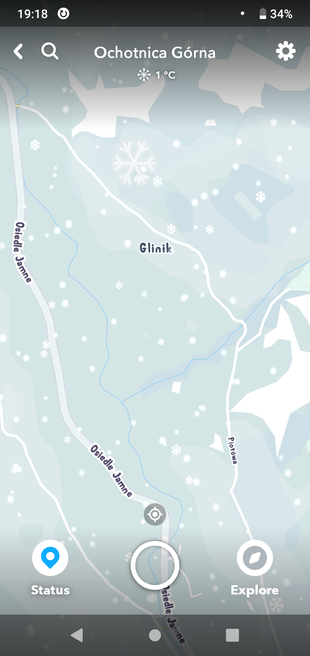
Snapchat
Email in 2019 (ignored).
Report via Mapbox as they use Mapbox hosting
- send in 2019. Assigned 77032 id.
Mapbox replied on 2020-01-13 that they gave Snapchat some unspecific deadline.
Reminders in 2020 and 2021 (also ignored).

Slide 29
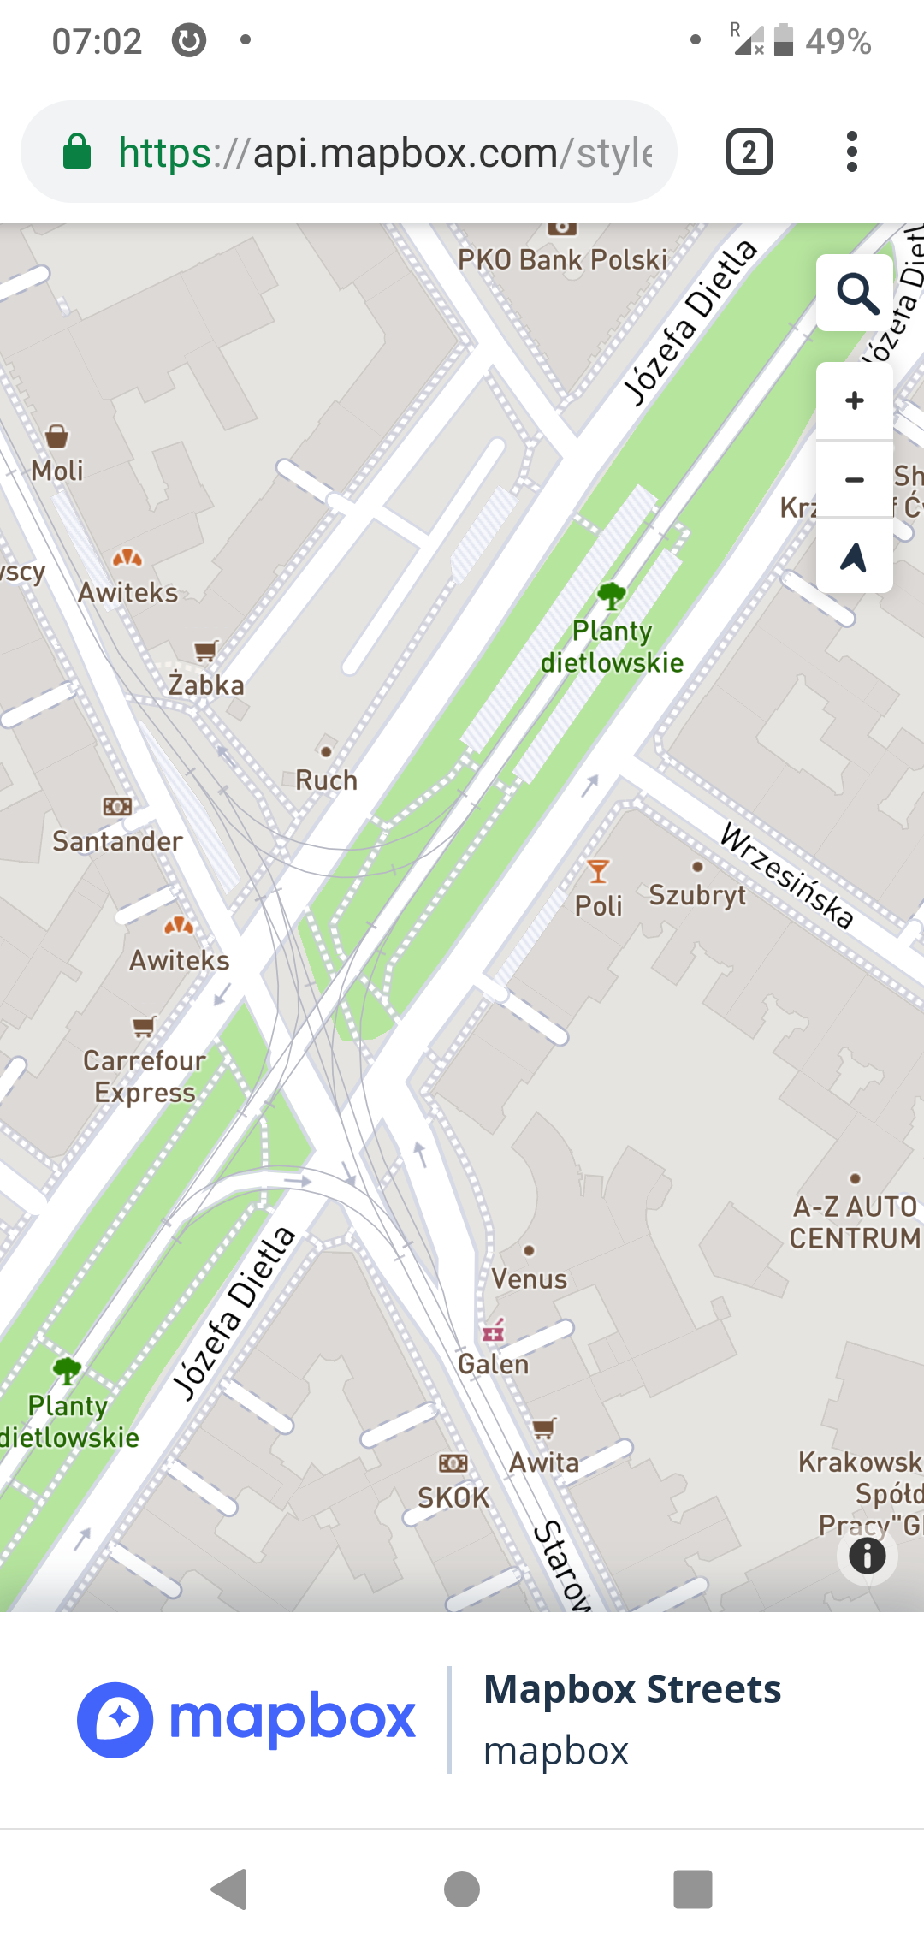
Mapbox
Reported in 2019 via their form
(report assigned id 77176)
Mapbox claims that showing OpenStreetMap attribution after the interaction while clearly attributing itself is fullfilling OdbL
(“notice associated with the Produced Work reasonably calculated to make any Person that uses, views, accesses, interacts with”)

Slide 30
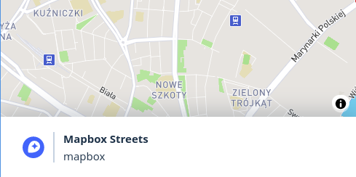
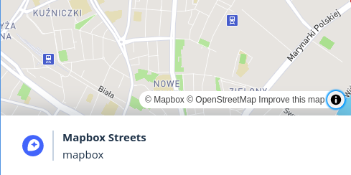
Mapbox
Reported in 2019 via their form
(report assigned id 77176)
Mapbox claims that showing OpenStreetMap attribution after the interaction while clearly attributing itself is fullfilling OdbL
(“notice associated with the Produced Work reasonably calculated to make any Person that uses, views, accesses, interacts with”)

Slide 31
What can be done?
Often a simple email works
  Examples from June 2021

Slide 32
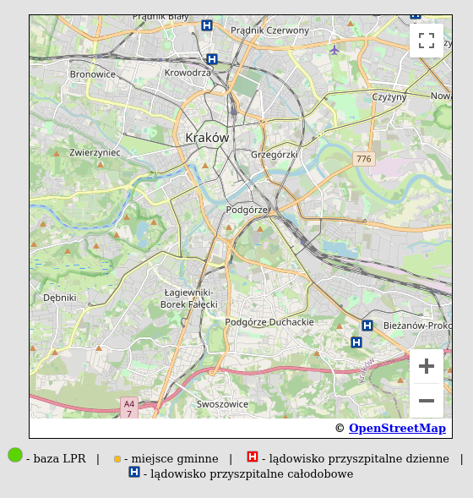
LPR landing map
https://www.lpr.com.pl/pl/ladowiska/mapa-miejsc-gminnych-oraz-ladowisk-przyszpitalnych/
at least they really tried
formerly Google logo on OSM map
(ues, full screen map is still broken)

Slide 33
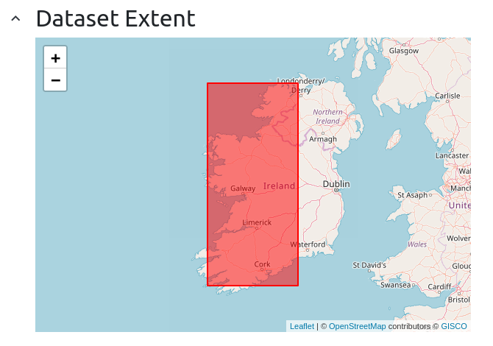
data.europa.eu
now credits OpenStreetMap
(formerly mentioned only GISCO,
responsible for the rectangle)
https://data.europa.eu/data/datasets
https://data.europa.eu/data/datasets/ead36f39-da76-4369-b35a-252e400b206a?locale=en

Slide 34
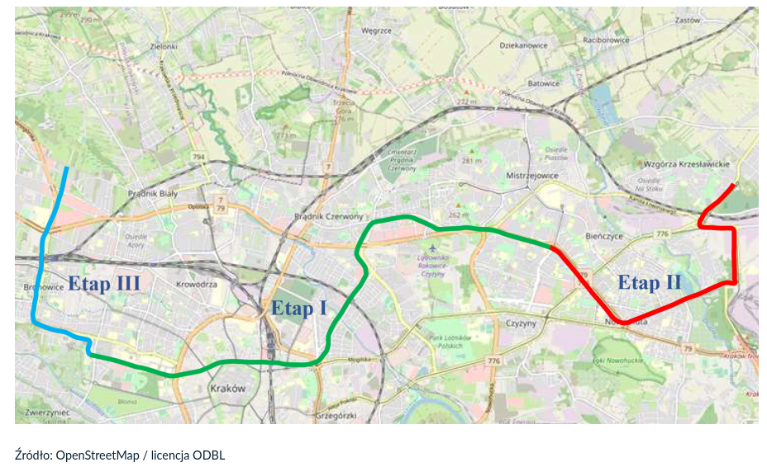
Kraków government
press release
https://www.krakow.pl/aktualnosci/250011,1912,komunikat,krakow_bedzie_mial_premetro.html

Slide 35
systematic copyright violation by XYZ
Hello!
As one of the authors, I am very happy to see OpenStreetMap data being used
But LINK and other pages on that site has a map with a misleading attribution.
It must be attributed to the actual data source, OpenStreetMap project. See https://www.openstreetmap.org/copyright
I recommend "© OpenStreetMap (ODBL)" linking to https://www.openstreetmap.org/copyright
In cases where Foobar data is also shown, I recommend "© Foobar © OpenStreetMap (ODBL) for background map" or similar.
-- Mateusz Konieczny

Slide 36
It often works!
But if problem is not fixed after reporting it, normal mapper has no good further steps
OSMF can and should act in such cases

Slide 37
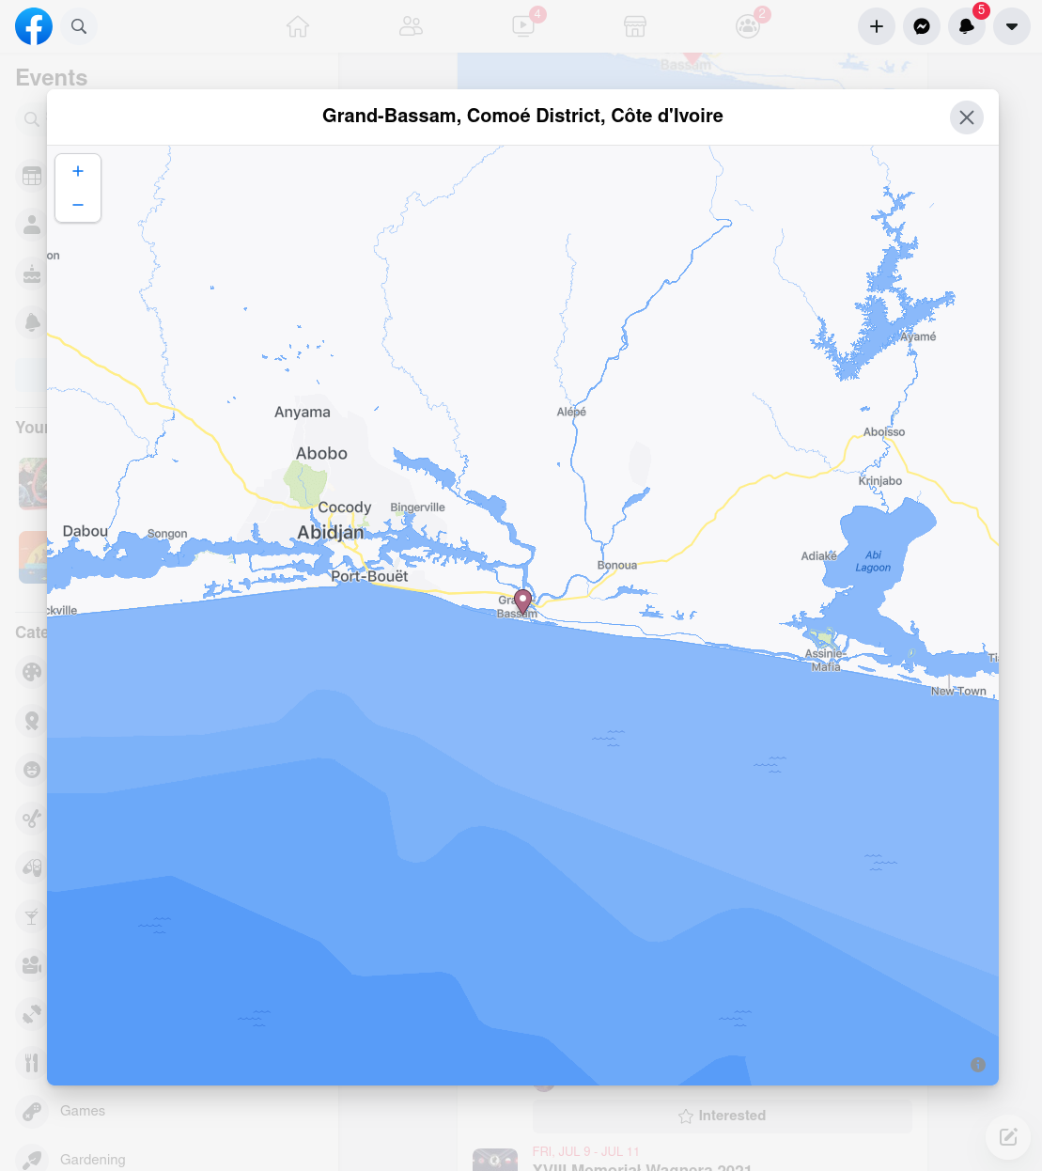
Facebook
Facebook is in business of selling attention of their users and their screen space.
Even full screen maps are hiding attribution and
require a click on weird button to see it.
Ad shown under every single map on their platform
would be worth massive amount of money and we are entitled to it

Slide 38
What would be the value of an ad under every single map on FB?

Slide 39
Conflict of interest
We should be aware that it is in our interest that a clear attribution will be visible
It is not in interest of various entities to attribute OpenStreetMap

Slide 40
Lets make OpenStreetMap known more widely
Ask users to clearly state source, it is one of our conditions
OpenStreetMap Foundation should act in cases where it is not sufficient
Useful to log reports on “Lacking proper attribution” page at OSM Wiki
https://wiki.openstreetmap.org/wiki/Lacking_proper_attribution

Slide 41
Right now we are
Losing potential contributors
  in way that preserves unusual demographics of OSM
Losing chances to grow awareness of OSM

Slide 42
Thanks!
To everyone who is using OpenStreetMap data and has honestly tried to credit it
  thanks also to people who fixed missing attribution

Slide 43
Thanks!
English is not my native language, let me know about what is the most important to improve.

Slide 44
Presentation text and slides are published
mapsaregreat.com/unknown

